Slide 1
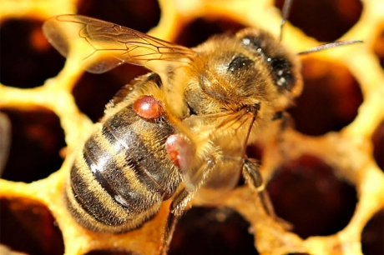
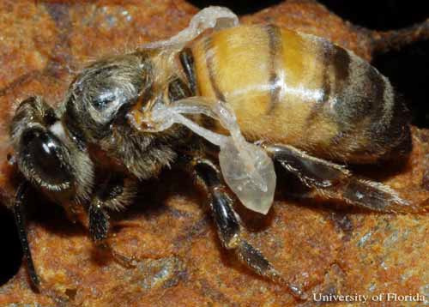
Long Term Solutions for Our
Bees
% non reproducing mites | VSH alleles | VSH %
100 | 4 | 100
67 | 3,5 | 87,5
50 | 3 | 75
33 | 2 | 50
25 | 1 | 25
20 | 0 | 0
Varroa Destructor
Deformed wing virus

Slide 2
Current Status of Our Battle with
Varroa Destructor
Varroa control is problematic
Varroa spreads brood disease and viruses
Colony death occurs from various viruses
Hard chemical treatments have or will fail
Soft chemical treatments are often ineffective
More frequent treatment is required
Cost of treatment is an issue
Long term solution is for bees to develop resistance
Progress for developing resistance is real!!

Slide 3
Varroa Sensitive Hygiene (VSH)
Developed by USDA Honey Bee Lab in Baton Rouge
Work has been going on since 1995 with Dr John Harbo and Dr Roger Hoopingarner discovering the VSH trait
Workers removed mite infested pupa at a certain age
Detect mite infestations by odor
Small percentage of workers able to sense infested cells
These workers spend all their time finding varroa infected cells
They open cell and insert their antenna to touch larva
Odor is not volotile and can only be sensed by touching pupa
Infected worker pupa are removed
Infected drone brood is not able to be sensed
Cells opened but not found infected are recapped
Bees have been bred that can remove 95% of mite infected brood

Slide 4
Honeybee Varroa Mite Development
from Arista Bee Research, The Netherlands

Slide 5
Cells Uncapped and Recapped by VSH Bees
Cells that have been
uncapped and recapped
Underside of cappings that have
been removed and recapped
Tape used for removing
capping

Slide 6
Current Status
Resistant queens are inbred producing spotty brood
Some breeders have been using resistant queens for long time with improving performance
Queens from resistant breeders loose 50% of VSH trait when open mated to non VSH drones
Large effort by European breeders to develop good performing queens (www.aristabeeresearch.org)
Current effort to import European stock with VSH traits
Efforts locally to produce VSH queens
VSH queens, queen cells and insemination service are available at www.harbobeeco.com

Slide 7
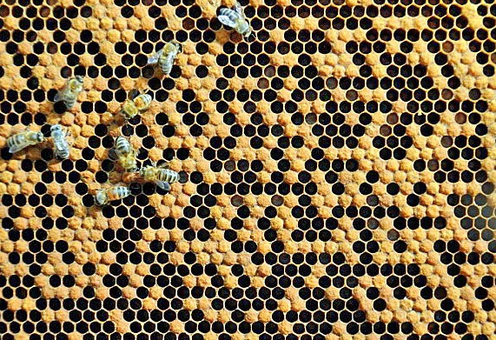
Inbred Queen Brood Pattern

Slide 8
Available VSH Queens
Available from Harbo Bee Co
Laying artifically inseminated queens are $300 ea
Not yet laying artifically inseminated queens are $150 ea
Insemination service of your queens $100 ea
Laying queens have observed good brood patterns
Fully VSH queens will have queen progeny when naturally mated will not require varroa medication!!

